Slide 1





DIGITAL SUPPLY
CHAIN
What is a digital supply chain?
watch the video

Slide 2
Supply Chain
In a typical supply chain, the flow of goods involves designing a product, sourcing and procuring the raw materials and parts, making the product, estimating demand, planning how you’ll market the final product, taking orders, arranging logistics and sales channels and then providing customers with visibility into their orders.
Digital Supply Chain
A Digital Supply Chain (DSC) refers to the integration of digital technologies to enhance, automate, and optimize the end-to-end supply chain processes, from procurement and manufacturing to delivery and customer service.

Slide 3
Importance of Digital Supply Chain
Increased efficiency and reduced costs Enhanced visibility and control
Better customer experience
Real-time data and analytics for decision-making
Interconnected and collaborative
Focus on customer satisfaction
Agile and responsive
Data-driven

Slide 4
Supply Chain Models
Traditional
Digital

Slide 5
Traditional Supply Chains
Sequential, linear processes
Reliant on paper-based communication
Limited real-time tracking
Example:
A manufacturing company relying on fax for orders and shipments.

Slide 6
Digital Supply Chains
Integrated across departments and stakeholders
Real-time monitoring and forecasting
Smart automation through AI and IoT
Example: The same company using an ERP system and IoT sensors to track production
and shipments in real-time.

Slide 7
Key Technologies Driving Digital Supply Chain Internet of Things (IoT)
Real-time monitoring of inventory, equipment, and shipments
Blockchain Transparency and security in transactions, contracts, and product traceability
Example: Walmart and IBM using blockchain to trace the origin of food products, ensuring food safety
Robotic Process Automation (RPA) Automating repetitive tasks such as order processing, invoicing, and inventory checks
Example: Automation of procurement and order fulfillment processes, reducing manual effort and errors
Example: RFID tags on products to track movement from warehouse to delivery
Artificial Intelligence (AI) and Machine Learning (ML) Predictive analytics for demand forecasting and route optimization
Example: AI-driven inventory management systems that predict restocking needs based on historical data.
Cloud Computing Centralized data storage and access across the supply chain, enabling real- time collaboration
Example: Google Cloud or AWS used to store and analyze supply chain data globally
Big Data Analytics Analyzing large volumes of data for trends, customer behavior, and optimization
Example: Using historical sales data to forecast demand more accurately

Slide 8


Discussion/Activity
How do these technologies complement each other in a digital supply chain?

Slide 9
Case Studies
Amazon's Digital Supply Chain
Amazon uses advanced AI algorithms to predict demand, IoT for real- time inventory management, and robotics in warehouses to automate processes. The company has created a highly flexible and scalable supply chain that can respond to demand spikes with minimal human intervention.

Slide 10
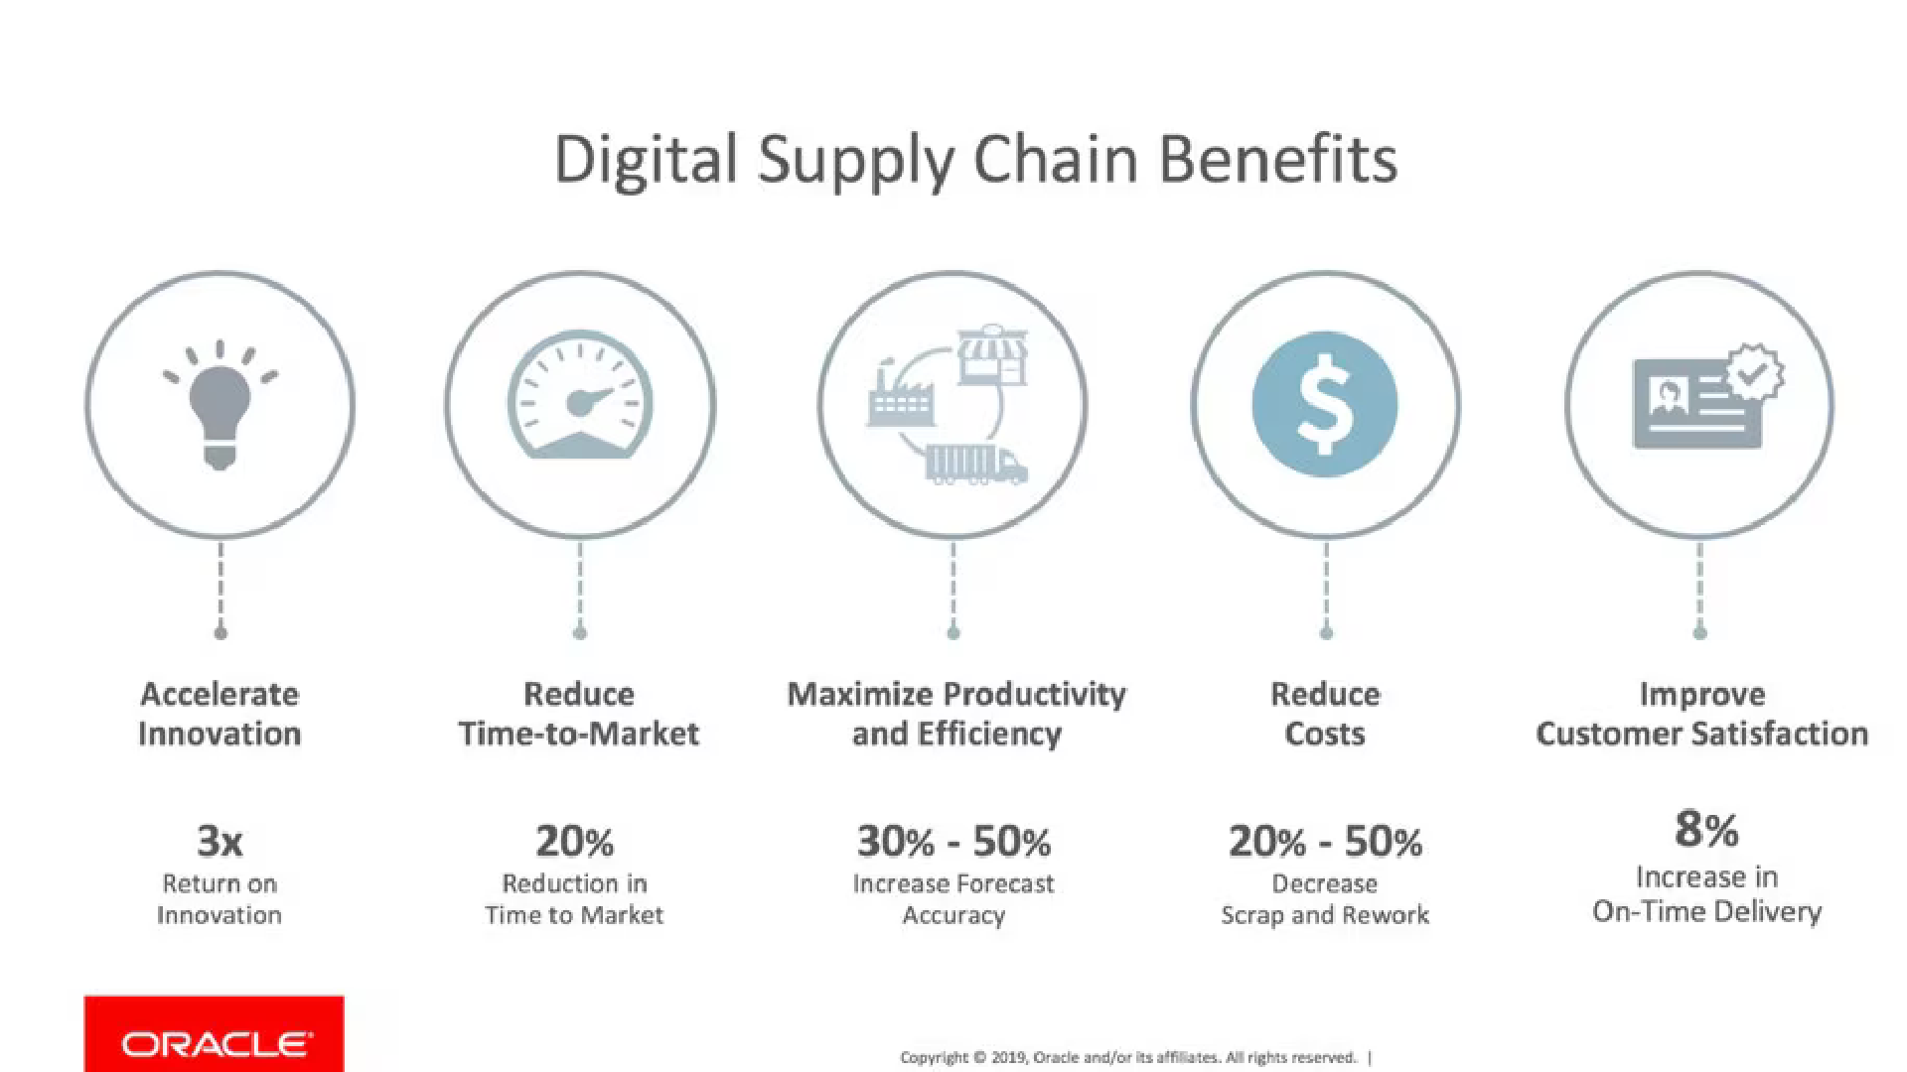

Slide 11

Case Studies
Zara and Fast Fashion
Zara has implemented a digital supply chain that includes real- time inventory tracking, fast data- driven decision-making, and agile production systems. They can design, produce, and deliver a new fashion collection in a matter of weeks, rather than months.

Slide 12
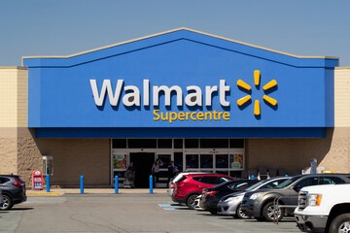
Case Studies
Walmart’s Blockchain Implementation
Walmart has adopted blockchain technology to track the journey of food products from farm to table.
This has not only improved transparency and food safety but has also helped reduce the time required to trace product origins from days to seconds.

Slide 13
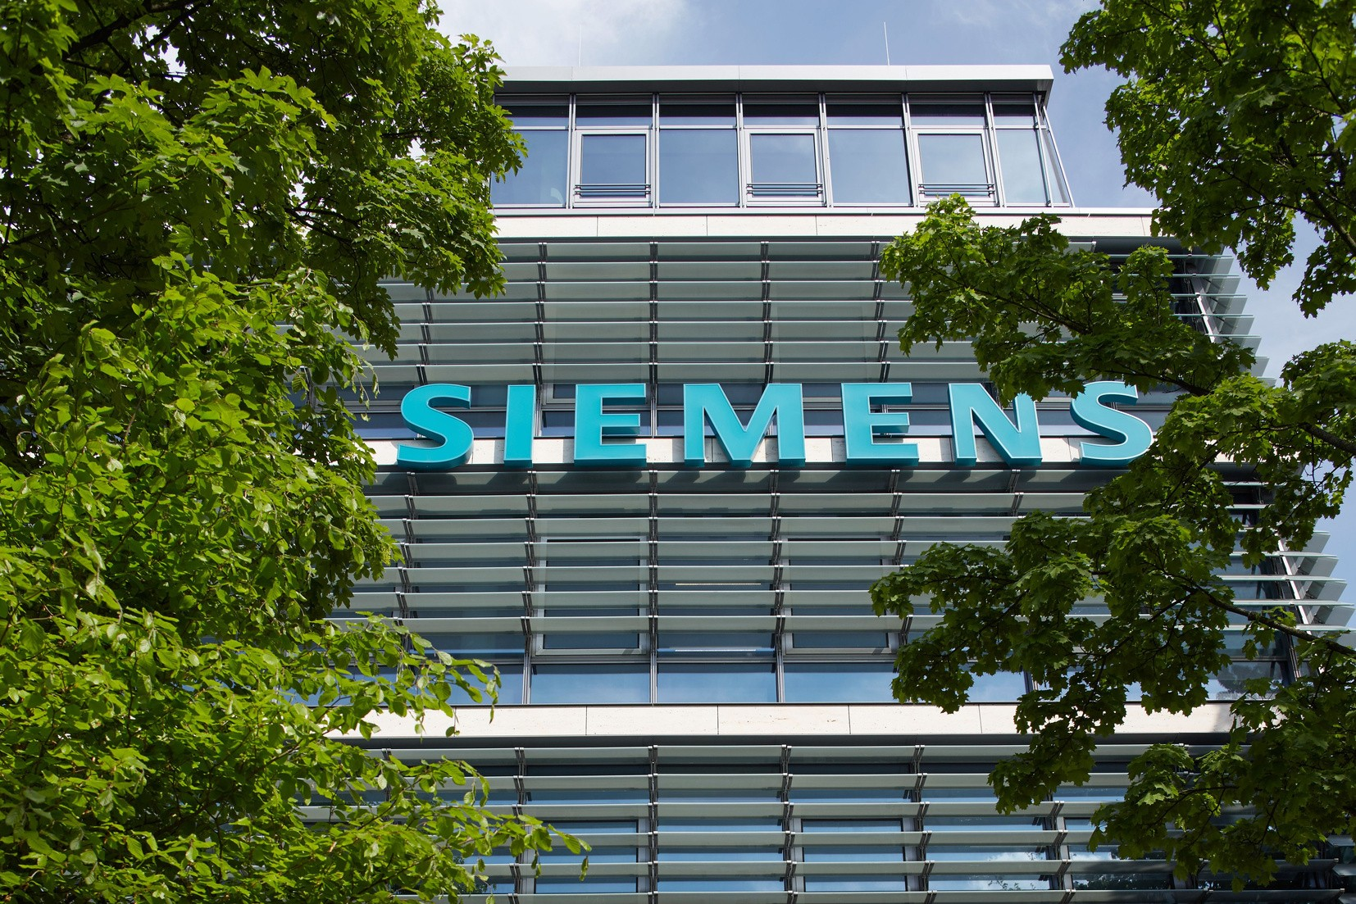
Case Studies
Siemens and Industry 4.0
Siemens uses IoT, robotics, and data analytics to improve production lines. Their smart factories allow for real-time data collection and analysis, which leads to optimized production schedules and reduced downtime.

Slide 14
Challenges in Implementing a Digital Supply Chain
Data Security and Privacy
Integration of Legacy Systems
Cost and Resource Allocation
Resistance to Change
The increasing volume of sensitive data raises concerns about
cybersecurity and privacy. Example: Data breaches leading to financial losses or brand reputation
damage.
Many companies struggle to integrate old systems with new digital technologies, leading to inefficiencies.
Example: A manufacturer with outdated ERP systems that cannot sync with cloud- based inventory management solutions.
Employees or management may resist new technologies due to lack of understanding or fear of obsolescence.
Example: Warehouse workers may resist robotic automation for fear of job loss.
Initial investments in technology and training can be high.
Example: Small businesses may struggle to afford AI or blockchain implementations.

Slide 15
Future of Digital Supply Chains
AI and Autonomous Vehicles The future could see greater use of self-driving trucks, drones for deliveries, and AI for autonomous supply chain management.
Digital Twins: Virtual models of physical supply chains will allow businesses to simulate changes and make better predictions.
5G and Edge Computing: Faster connectivity will enable near- instantaneous data transmission, enhancing the responsiveness of digital supply chains.

Slide 16

Discussion
What technological advancements do you think will have the biggest impact on supply chains in the next 5-10 years?

Slide 17




















Homework Assignment: Research Project:
Students can choose a company and research how they have implemented digital supply chain technologies, focusing on the challenges they faced and the benefits realized.

Slide 18

Thank You!!!

